Slide 1
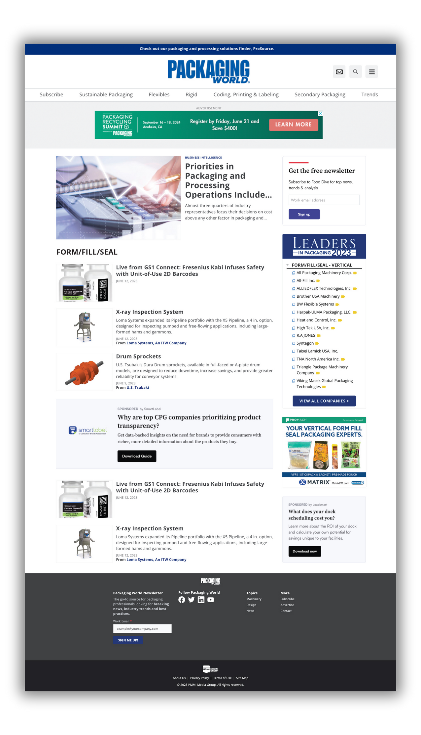


Category Roadblock

Slide 2

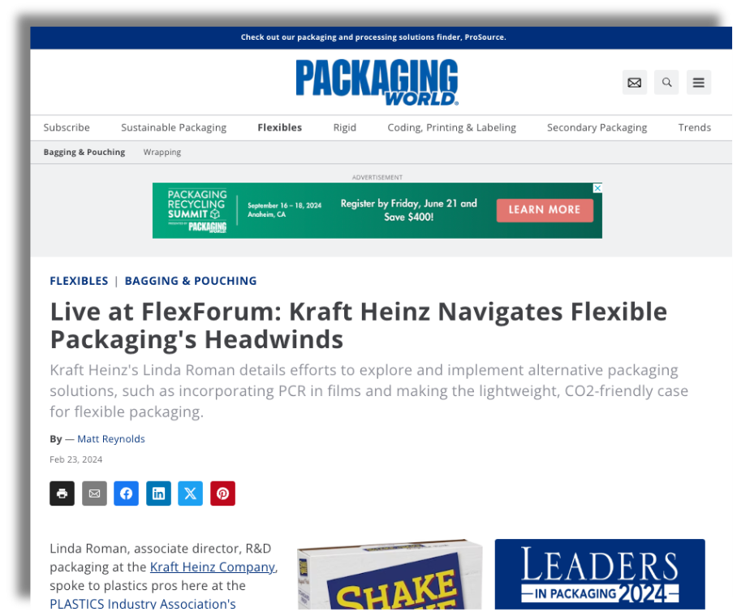
Category Roadblock
Articles and other pages
Pro Tip
Tagged Content Throughout the site
You can tell what the primary tag is for Articles and other pieces of content on the site by looking the eyebrow. If the purchased category is in the eyebrow the advertiser’s roadblock should appear.
Articles and other content tagged with the category purchased as primary will have a roadblock
ad as well.

Slide 3

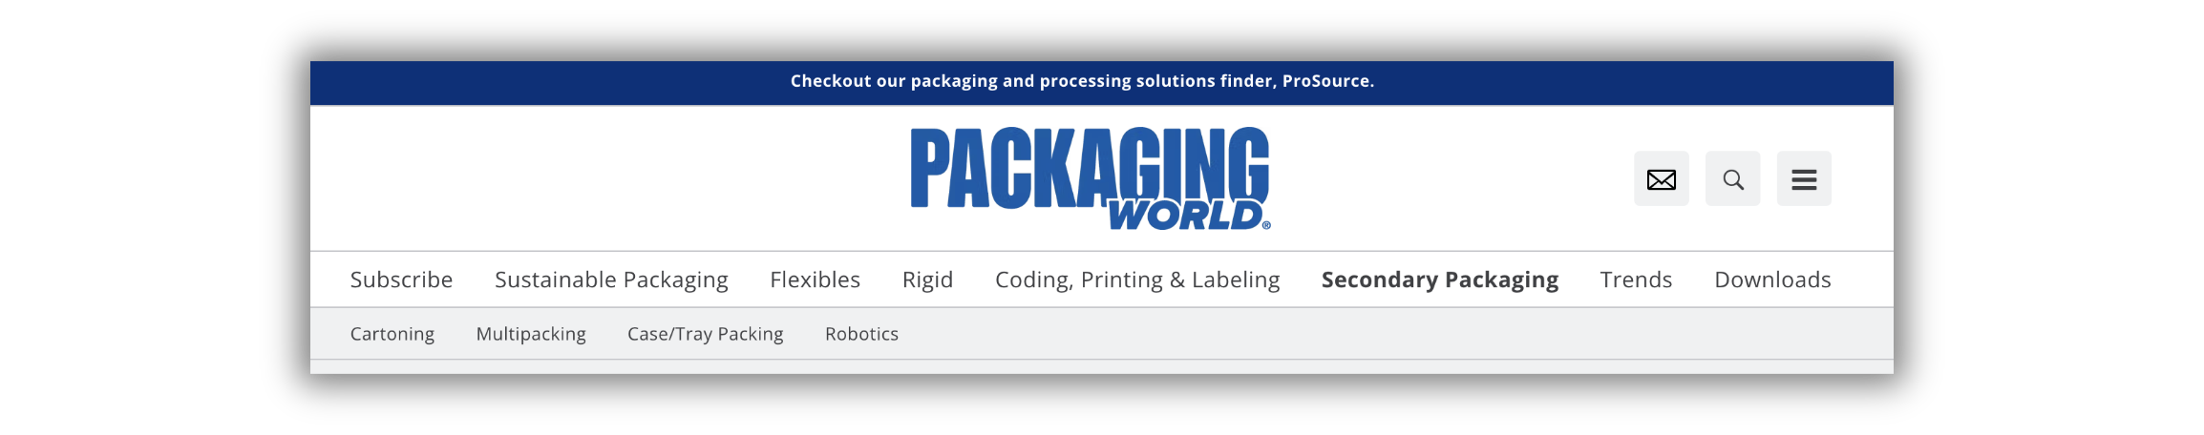
  Sustainable Packaging
    Recycling
    Bio-based
    Reusable/Returnable
  Flexibles
    Bagging & Pouching
    Wrapping
  Rigid
    Filling, Capping & Closing
    Containers & Closures
  Coding, Printing & Labeling
    Labeling
    Coding & Marking
    Package Printing
  Secondary Packaging
    Cartoning
    Multipacking
    Case/Tray Packing
    Robotics
  Trends
    Contract Packaging
    Logistics/Supply Chain
    Controls & Machine Components
    E-commerce/D2C Packaging
    Package Design
Category Roadblock
Packaging World Navigation Terms Available

Slide 4
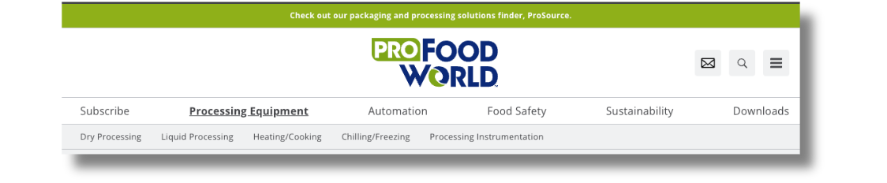
Category Roadblock
  Processing Equipment
    Dry Processing
    Liquid Processing
    Heating/Cooking
    Chilling/Freezing
    Processing Instrumentation
  Automation
    Robotics
    Controls
    IIoT
    Security
    Software
    Workforce
  Food Safety
    Cleaning & Sanitation
    Regulatory
    Pest Control
    Inspection
    Sterilization/Pasteurization
  Sustainability
ProFood World Navigation Terms Available

Slide 5

Duration, Pricing and Performance
1 Month Campaigns
3 Month Campaigns*
  Minimum 16K Impressions
  No bonus impressions
  Price: $6,000
  Minimum 50K Impressions
  10K bonus impressions on parent category pages.
  Price: $15,000
PACK EXPO Pricing:
$7,500 (Aug/Sept/Oct)
*3 consecutive months

Slide 6

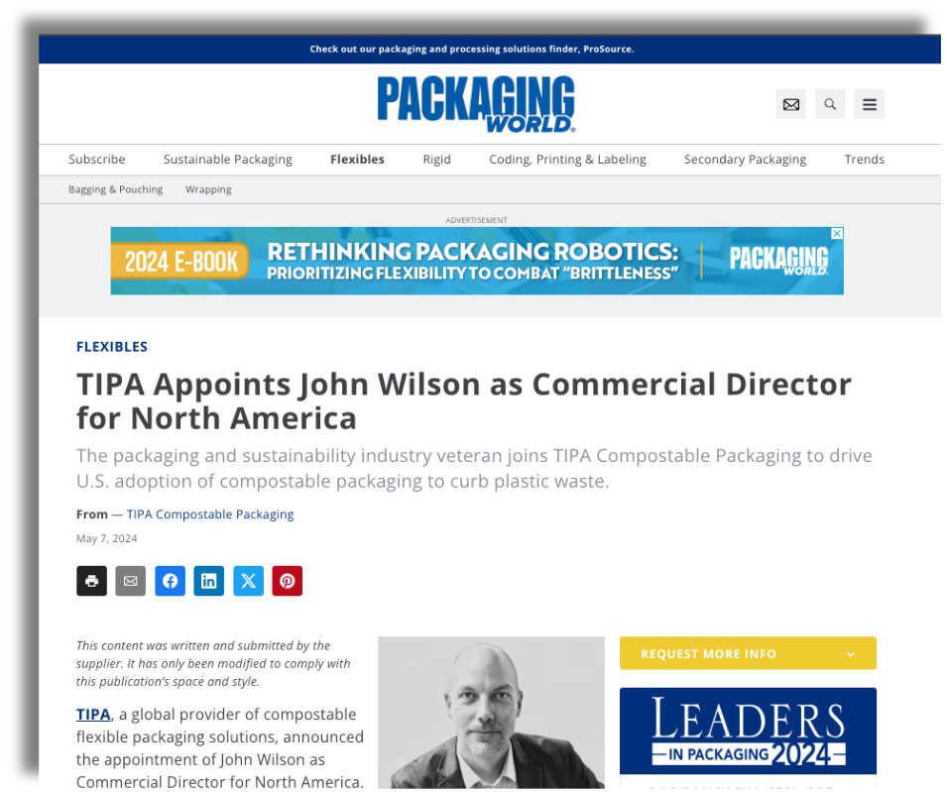
Category Roadblock
Bonus Impressions
10K bonus impressions will appear on category and content pages tagged with the parent category.
Example: If an advertiser purchased the Wrapping category. They would get their bonus impressions on content tagged with Flexibles.
NOTE: Ads will always appear as roadblocks.

Slide 7



Category Roadblock
Reporting and Inventory
REPORTING: This is an awareness product, so the key metric is impressions. But we will also report clicks and CTR .
01
INVENTORY - RUN OF SITE ADS: We will cap run of site purchases at 10K a month. Reps/CSMs can ask for exceptions to this rule and Jenn Brink will check if feasible.
02

Slide 8

Category Roadblock
Ideal Advertiser
Larger Budget
Wants Category Dominance
Can produce multiple banner ads and has two pieces of high value content to promote via native ads.
Has a clear, direct message they want to get across to a targeted segment of our audience.

Slide 9

Category Roadblock
Key Benefits
Position your brand as a leader in a specific category by dominating that category on our site.
01
A great opportunity to reach web readers, which are different than print subscribers and PAN audiences.
02

Slide 10


Category Roadblock
Value Proposition
Own exclusive promotion rights to a targeted segment of our web audience while they’re researching a topic associated with your solutions.

