Slide 1





Game Plan

Slide 2




Game Plan Sales to date
Game Plan 2023 vs 2025
Revenue Year to date
Orders with Game Plan
488k
461k
107
101
2023
2025
2023
2025
  2023 total Game Plan Revenue was 855k
  2023 had 196 orders with Game Plan

Slide 3




Distribution changes
for 2025
At show distribution of category focused books

Slide 4



Distribution Plans
3 - 7 bin locations
Special bins
Includes Sustainability Finder
Located through all halls
Designing bins & signage
Included in all at-show copies

Slide 5















Game Plan Category Breakouts
01
02
03
04
05
06
Multi-Packing/End-of-line
Bagging, Pouching & Wrapping
Filling, Capping & Closing
Coding, Labeling & Printing
Conveying, Feeding & Handling
Food Processing
*Bins will include the Facilities & Infrastructure Directory!

Slide 6
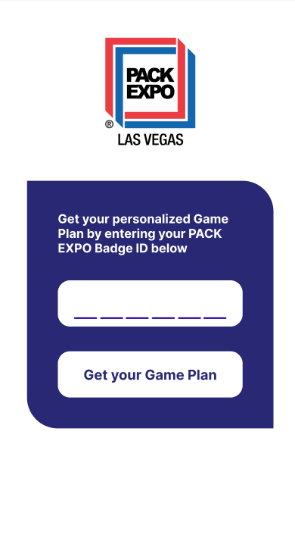
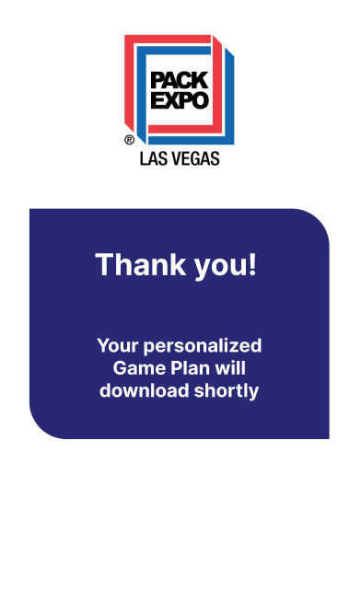
Game Plan
look up
First time ever!!
Look up my personal Game Plan QR code

Slide 7



Pricing change

Slide 8

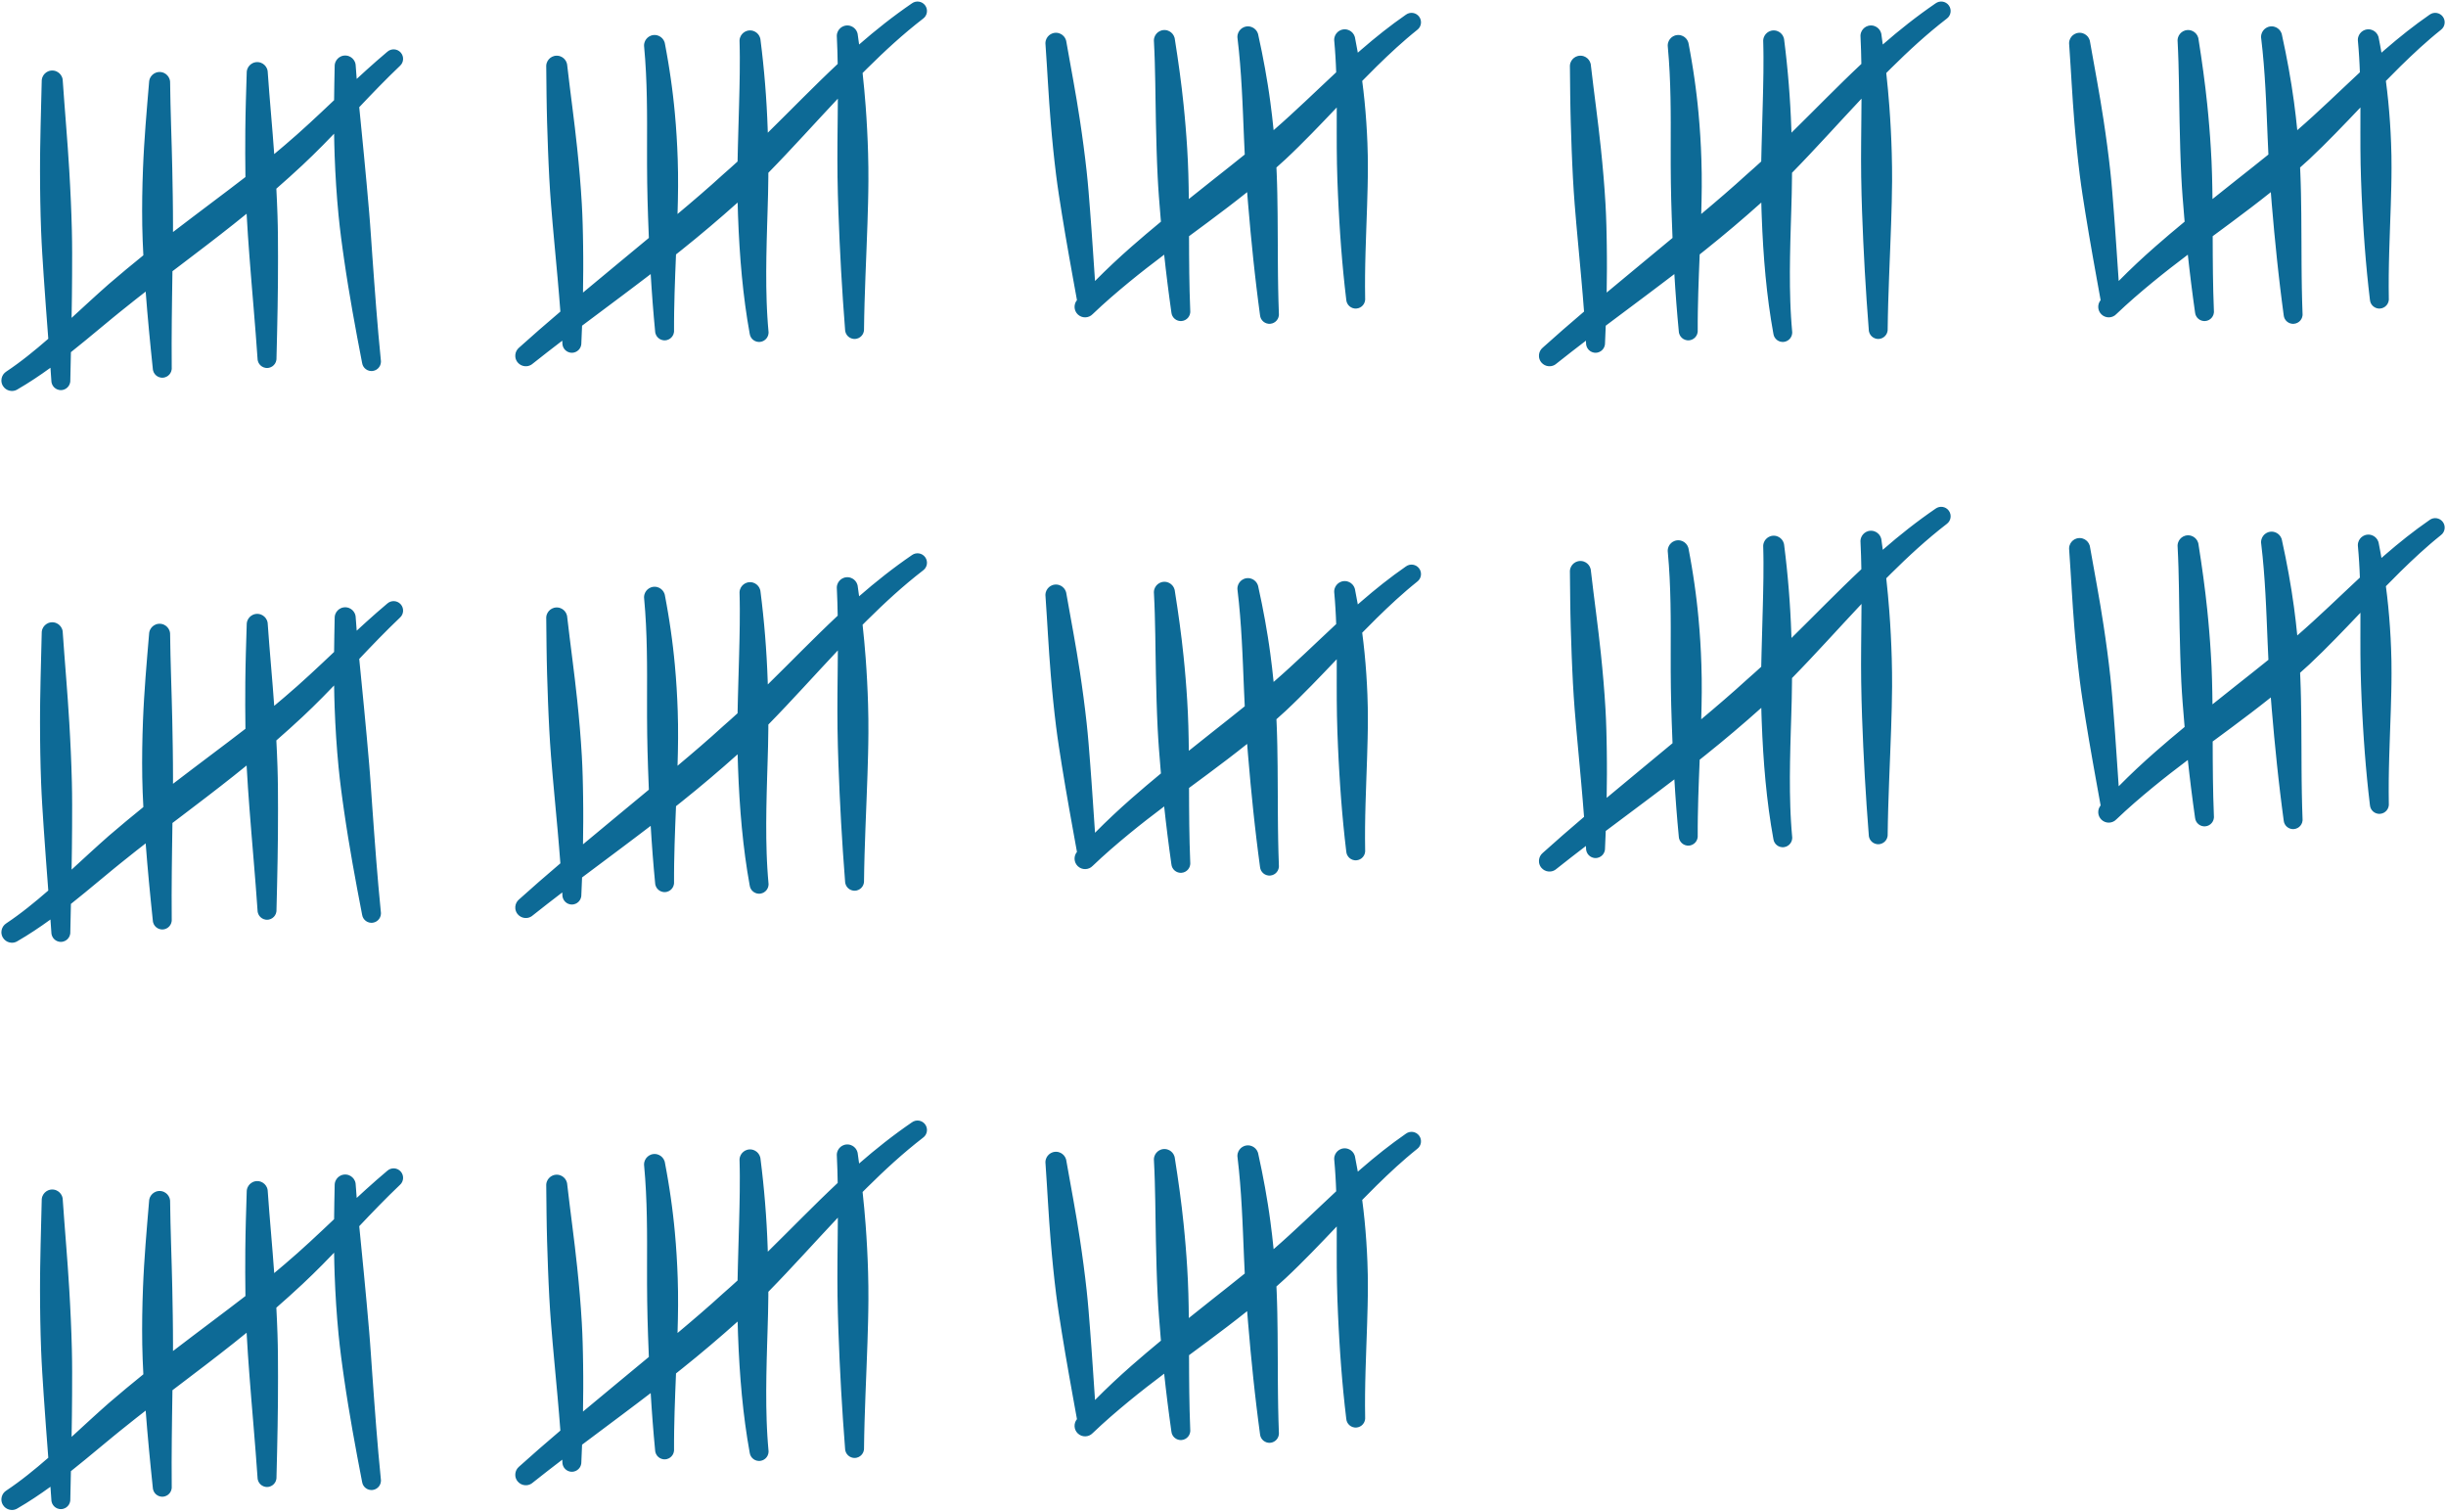
Questions & Follow up
Complete list of categories and sub categories (will be in chatter & posted to Hub)
Final bin locations and distribution counts

Slide 9

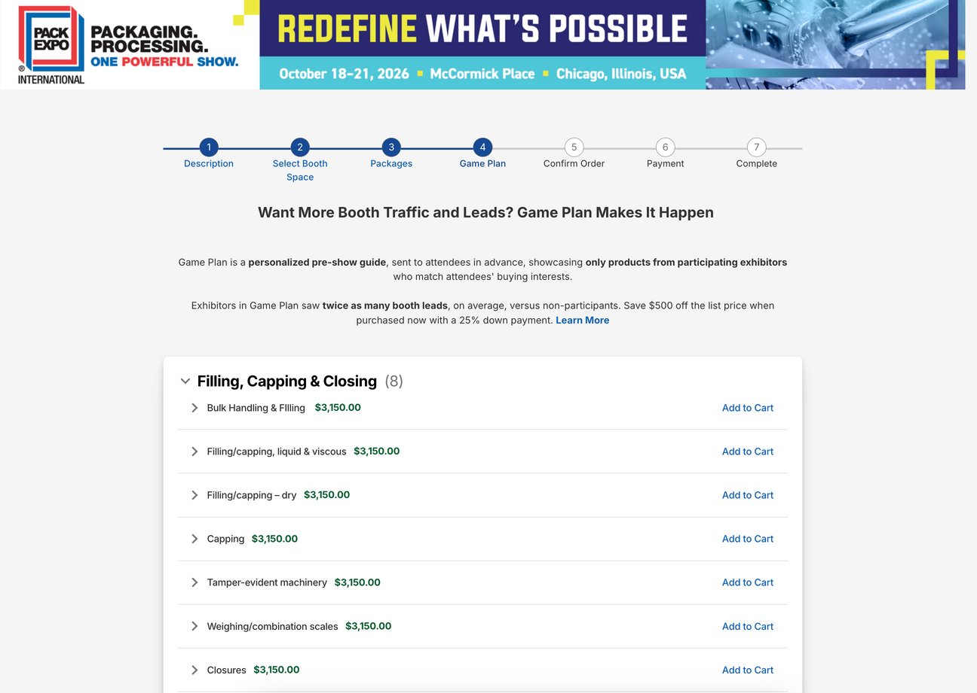

Exhibitor Application Game Plan Sales
Exhibitor application
Exhibitors can add Game Plan categories when they purchase their booth
Game Plan pricing
Prices are reduced when purchased through exhibitor application

Slide 10


Reasons & pricing
Exposure of Game Plan
Ease of exhibitor purchase
Pricing
More exhibitors will know about Game Plan! If you get an exhibitor lead they’ve seen it once already!
Easy “one click” purchase & billed in installments to make it seem a “no brainer”
$500 discount for one category - multiple category discounts on hub.
NO additional Member discount applies!

Slide 11
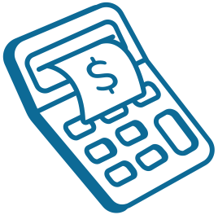

Questions & Follow up
  19 companies
  25 total categories
Other questions?

